Slide 1
What is a Comprehensive Transportation Plan (CTP) and Community Understanding Report (CUR)?
Copy/paste any of the icons below into your presentation. Please change color to white if using them on a dark background.
Pam R. Cook, P.E.
Emily Stupka
NCDOT Transportation Planning Division
December 8, 2023

Slide 2
What is A CTP?
Other slide variations are available. Select Insert above and click on the drop menu beside “new slide” to see all the options.
What Is a CTP and CUR?
Comprehensive Transportation Plan
It is long range needs-based plan (~25-30 years)
Represents an area’s consensus on a future transportation system
It is multimodal
Highway
Bicycle / Pedestrian
Public Transportation / Rail

Slide 3
What is A CTP?
Other slide variations are available. Select Insert above and click on the drop menu beside “new slide” to see all the options.
What Is a CTP and CUR?
Comprehensive Transportation Plan
Developed cooperatively with:
NCDOT
Municipalities
Counties
Rural Planning Organizations
The public

Slide 4
What is A CTP?
Other slide variations are available. Select Insert above and click on the drop menu beside “new slide” to see all the options.
What Is a CTP and CUR?
Comprehensive Transportation Plan
It is adopted or endorsed at three levels:
Locally
Rural Planning Organization
NCDOT Board of Transportation
It is the first step of the development of a project

Slide 5
CTP Recommendations
Other slide variations are available. Select Insert above and click on the drop menu beside “new slide” to see all the options.
What Is a CTP and CUR?
Are planning level plans – are not design plans
Are concepts
Will go through a more detailed environmental review and design before final decisions are determined once they are programmed

Slide 6
How a CTP fits into the Construction process
Other slide variations are available. Select Insert above and click on the drop menu beside “new slide” to see all the options.
What Is a CTP and CUR?
Long-Range Planning
Determining the Need
CTP
Prioritization & Funding
Project is scored and funded
Project Planning and Design
Minimize Impacts, Refine, and Design
Construction
Building the Project
Maintenance and Operations
Make infrastructure last longer and perform better

Slide 7
NC State Statute § 136-66.2
Other slide variations are available. Select Insert above and click on the drop menu beside “new slide” to see all the options.
What Is a CTP and CUR?
Established the Comprehensive Transportation Plan
Each municipality and Metropolitan Planning Organization (MPO), with cooperation of the Department of Transportation, shall develop a comprehensive transportation plan…
…will serve present and anticipated travel demand….
The plan shall be based on the best information….
….consideration shall be given to all transportation modes….
After completion and analysis of the plan, the plan shall be adopted…
….shall provide opportunity for public comments prior to adoption….

Slide 8
CTPs consider projects and data from other plans
Other slide variations are available. Select Insert above and click on the drop menu beside “new slide” to see all the options.
What Is a CTP and CUR?
A sampling of the data considered in a Comprehensive Transportation Plan
Local & Statewide Transportation Plans
ANALYSIS
Local & Statewide Bike / Ped / Transit Plans
CTP
State Transportation Improvement Program (Funded)
Local Land Development or Land Use Plans

Slide 9
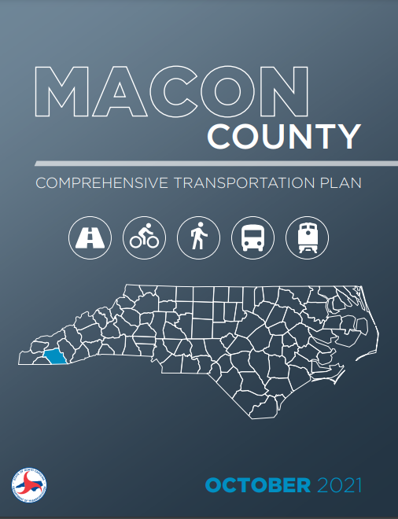
CTP Products
Other slide variations are available. Select Insert above and click on the drop menu beside “new slide” to see all the options.
What Is a CTP and CUR?
Deliverables an area will receive from the CTP Process
User friendly documentation
Covers study highlights

Slide 10
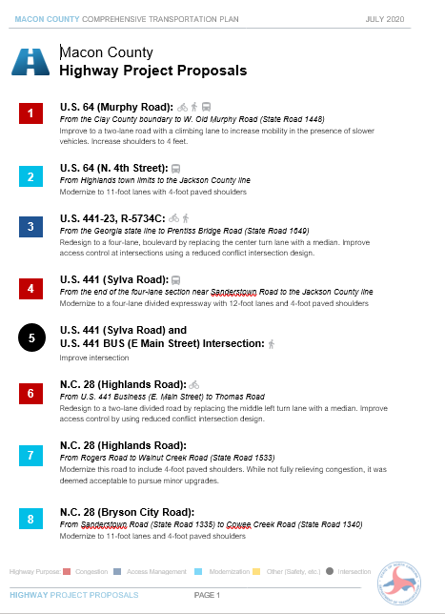
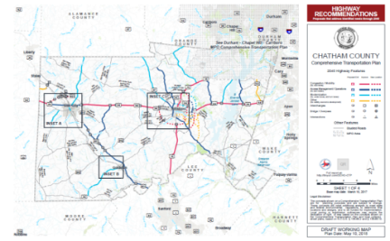
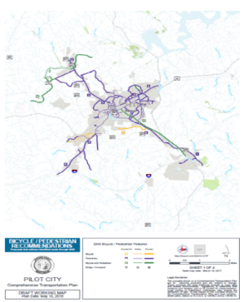
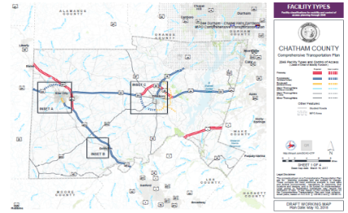
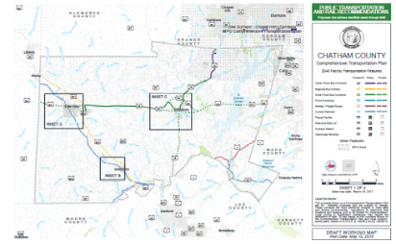
CTP Products
Other slide variations are available. Select Insert above and click on the drop menu beside “new slide” to see all the options.
What Is a CTP and CUR?
Deliverables an area will receive from the CTP Process
Recommendations Lists
Recommendations Maps

Slide 11
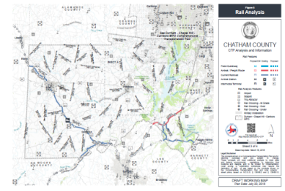
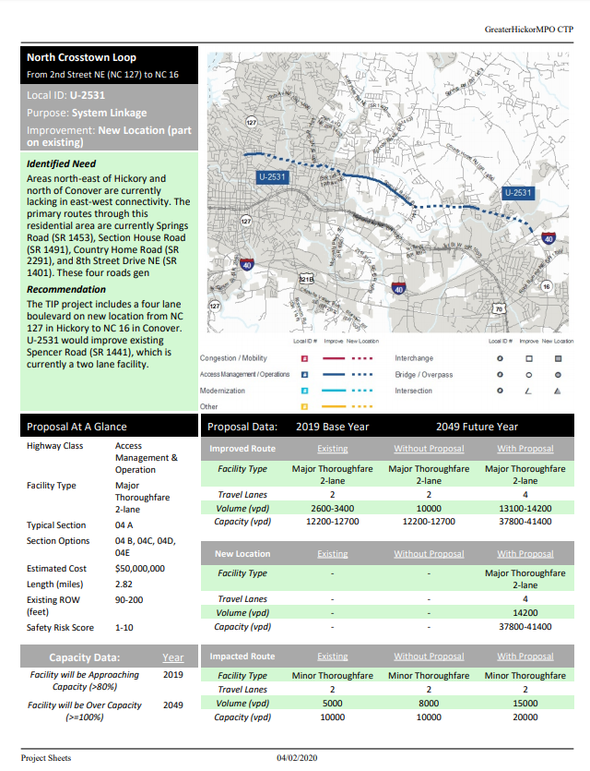
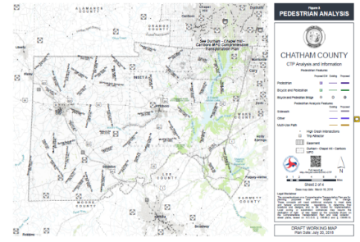
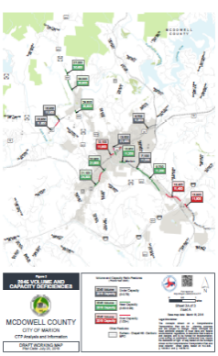
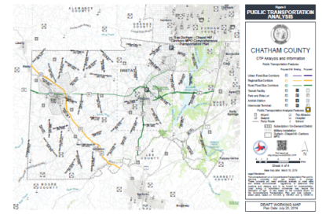
CTP Products
Other slide variations are available. Select Insert above and click on the drop menu beside “new slide” to see all the options.
What Is a CTP and CUR?
Deliverables an area will receive from the CTP Process
Analysis and Informational Maps
Project Sheets

Slide 12
What is A CUR?
Other slide variations are available. Select Insert above and click on the drop menu beside “new slide” to see all the options.
What Is a CTP and CUR?
It is a pre-CTP document completed by local area with some questions being answered during the CTP process.
Provides an overview of the CTP area.
It helps inform the identification of Stakeholders and Steering Committee Members.
It helps inform a public outreach plan for the CTP.
It helps to inform the vision, goals and objectives for the CTP
Provides data that helps inform the CTP process and recommendations.
It helps inform the regional travel demand model that covers the area (Piedmont Regional Travel Demand Model)
Community Understanding Report

Slide 13
Topics Covered by the CUR
Other slide variations are available. Select Insert above and click on the drop menu beside “new slide” to see all the options.
What Is a CTP and CUR?
Population Trends and Projections
Population Diversity
Community Character
Key Destinations (Schools, Parks, and Community Centers)
Public Safety/Emergency Response
Economic Conditions
Development Goals
Agricultural/Farming Operations

Slide 14
Keep in mind
Other slide variations are available. Select Insert above and click on the drop menu beside “new slide” to see all the options.
What Is a CTP and CUR?
Answer questions from your area perspective (town, county, company, community)
We are gathering information today and not developing CTP solutions to any identified issues (we will document identified issues to be considered during the development of the CTP with the CTP Steering Committee.
If a question is not relevant to the area, it is ok to skip it. “N/A” is also an appropriate response.
It is ok to skip questions if we don’t have the data to answer the questions today.
We can rephrase a question to better get at how the subject of the question impacts this study. “Where are farmlands and timberlands located in the study area?” It may be changed to “Are there particular routes that are impacted by farming or truck traffic?”.
There are some questions that will be answered during the CTP process by the CTP Steering Committee.
We want to document resources used to answer questions today.

Slide 15
Other slide variations are available. Select Insert above and choose “new slide” to see all the options.
Pam R. Cook, P.E.
Emily Stupka
Dawn Vallieres
prcook@ncdot.gov
elstupka@ncdot.gov
dvallieres@ptrc.org
919-707-0975
919-707-0985
336-904-0300
Project Website: connect.ncdot.gov/projects/planning/Pages/CTP-Details.aspx?study_id=Rockingham County

Slide 16
Other slide variations are available. Select Insert above and choose “new slide” to see all the options.

